Slide 1

Module 1
Regression Basics
Notes:
Guidelines
Use section headers to chunk content in your presentation.
Use the same style of section header throughout your presentation.
Keep your title to no more than 2 lines.

Slide 2
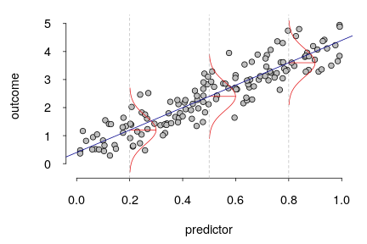
Inference on the Slope
Notes:
Guidelines
Use a title slide at the beginning of your presentation. There are 9 variations of title slides to choose from.
If you will have a series of slideshows, we recommend using the same style of title slide for each presentation.
Keep your title to no more than 2 lines.
Do not change the font style or font size of the title or subtitle.

Slide 3
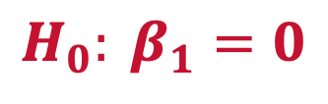
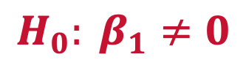
Hypothesis Tests on the Slope
We assume
Unless we have sufficient evidence to show that
$$H_{0}: β_{1}=0$$
No linear relationship between Cost and Earnings
$$H_{0}: β_{1}≠0$$
Linear relationship between Cost and Earnings

Slide 4
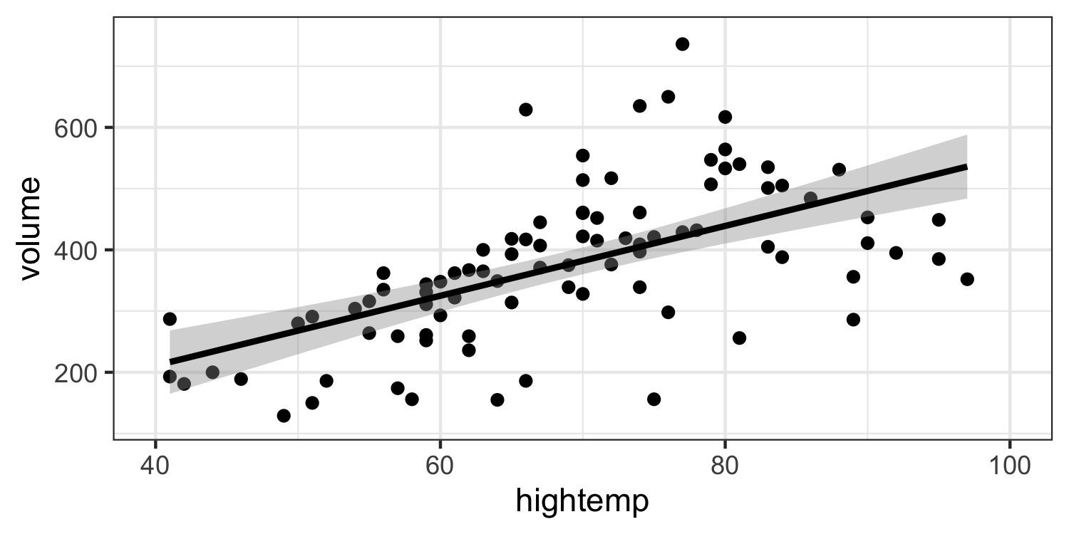


Hypothesis Tests on the Slope
The slope $β_{1}=0$ means that regardless of the value $x$, $y$ will be the same
$$β_{1}=0$$

Slide 5
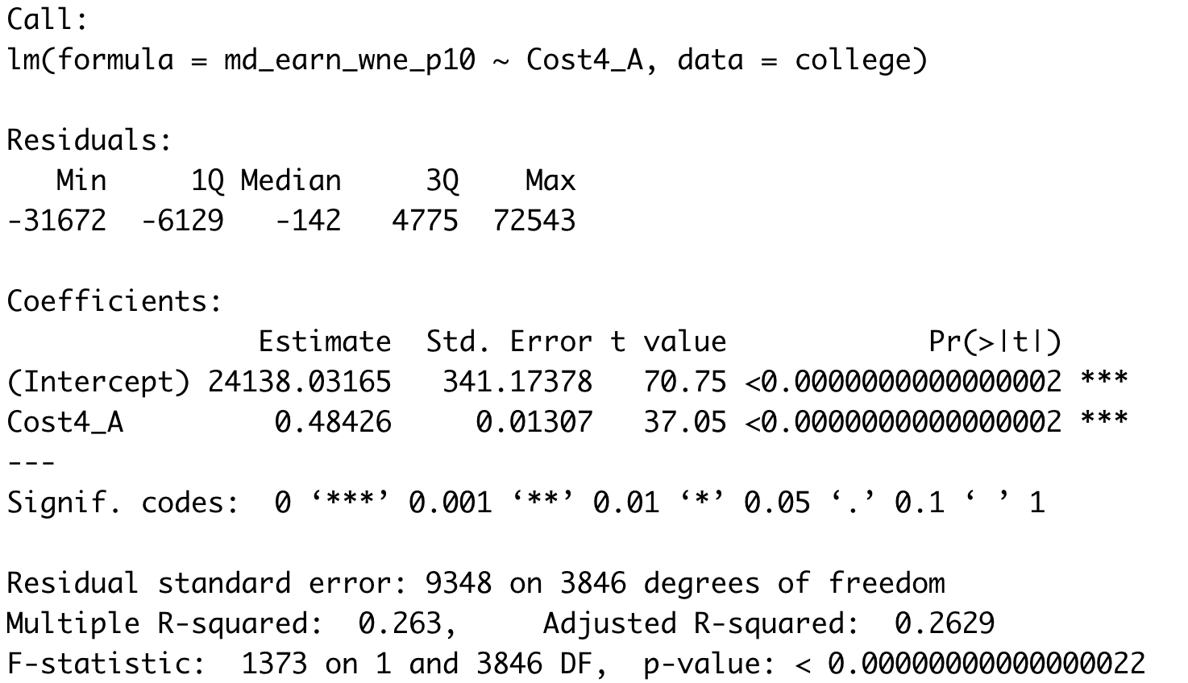
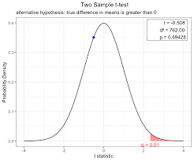



How Do We Get Evidence Against $H_{0}$?
If the sample slope ${\hat{β}}_{1}$ is far away from zero
However, we have to standardize the value
$$t=\frac{b_{1}−0}{s_{b_{1}}}$$

Slide 6

Practice

Slide 7
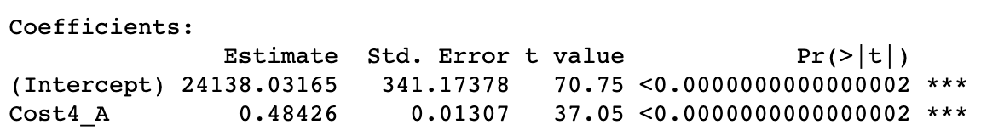
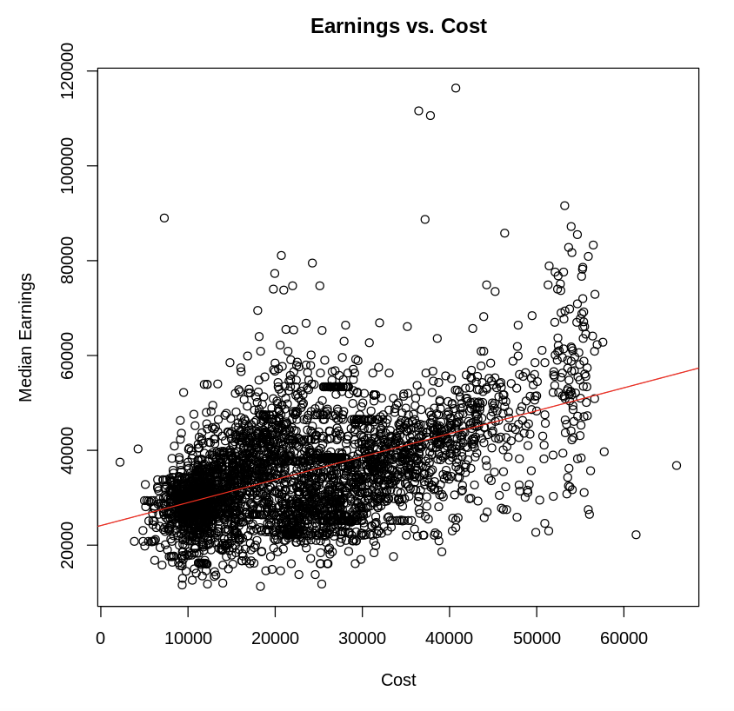
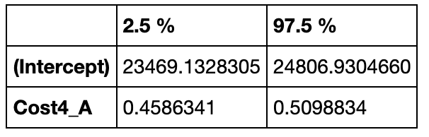



Confidence Interval on $β_{1}$
We can construct a confidence interval on $β_{1}$
95% CONFIDENCE INTERVAL ON $β_{1}$

Slide 8
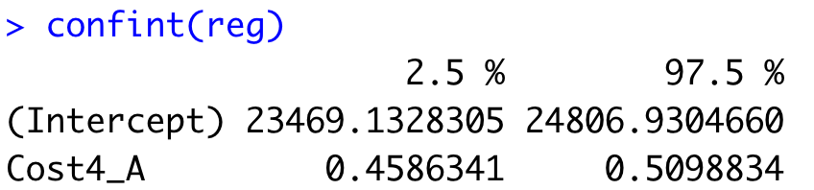
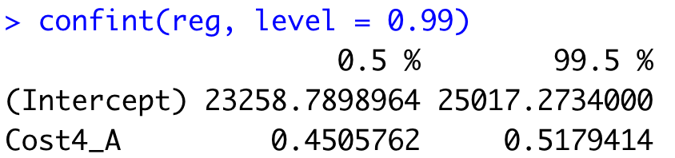


Confidence Interval on $β_{1}$
We can construct a confidence interval on $β_{1}$
95% CONFIDENCE INTERVAL ON $β_{1}$
99% CONFIDENCE INTERVAL ON $β_{1}$

Slide 9
Practice

Slide 10
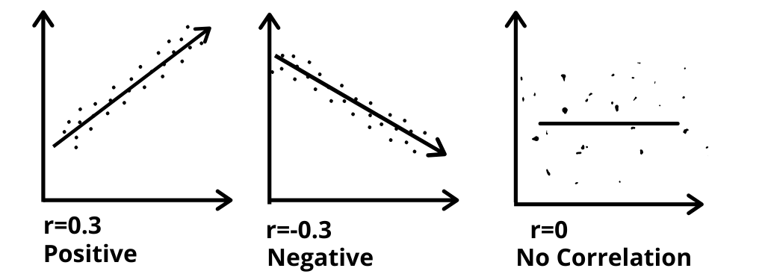
Correlation Coefficient
Measures linear relationship

Slide 11
Practice

Slide 12
R2 (Coefficient of Determination)
For Simple Linear Regression, it is the squared value of the correlation coefficient
R²

Slide 13
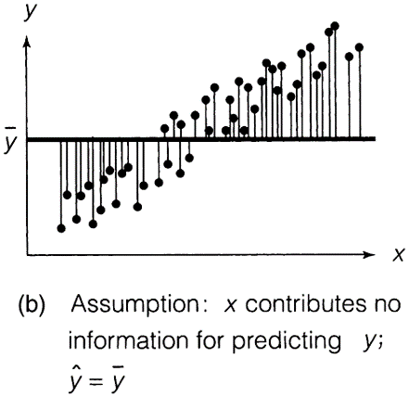
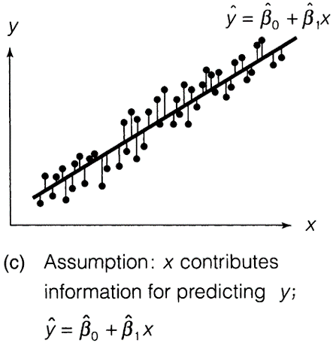
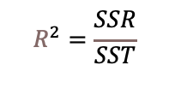
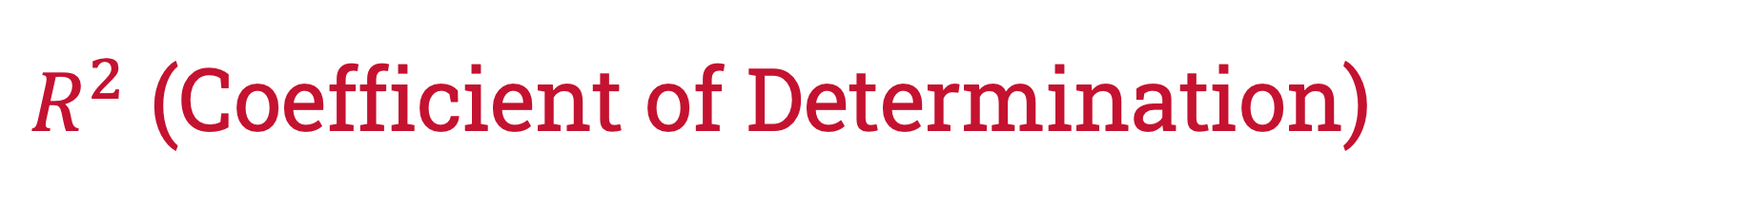


$R^{2}$ (Coefficient of Determination)
SST: total variation, SSR: Explained Variation,
SSE: unexplained variation
$R^{2}$ is the ratio is the ratio of explained variation to total variation
TOTAL VARIATION OF Y (SST)
$$R^{2}=\frac{SSR}{SST}$$
SUMS OF SQUARED ERRORS (SSE)
$SSR$ = $SST−SSE$

Slide 14
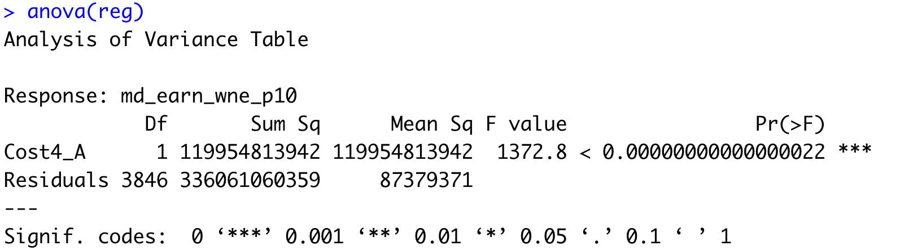
$R^{2}$ (Coefficient of Determination)
SST: total variation, SSR: Explained Variation,
SSE: unexplained variation
$R^{2}$ is the ratio is the ratio of explained variation to total variation
SSR
SSE

Slide 15
Practice

Slide 16
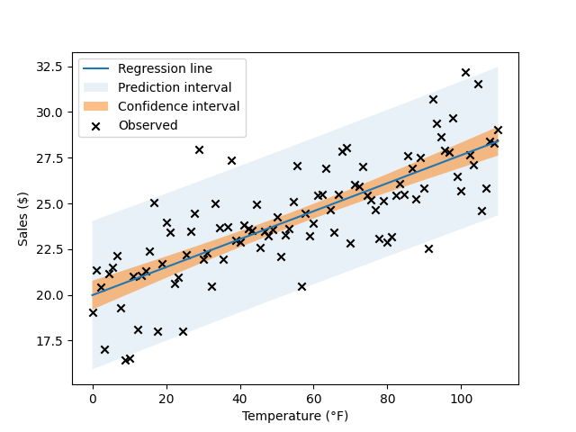

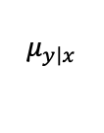

Point Estimates
A point estimate refers to the prediction of $y$ for a given value of $x$.
$$\hat{y}$$
estimates
$$μ_{y\left|x\right.}$$

Slide 17

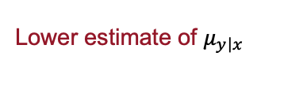


Confidence Interval on $μ_{y\left|x\right.}$
A confidence interval is a range for the average value of $y$ for a given value of $x$.
Upper estimate of $μ_{y\left|x\right.}$
Lower estimate of $μ_{y\left|x\right.}$

Slide 18


Prediction Interval on $y$
A confidence interval is a range for the average value of $y$ for a given value of $x$.
Upper prediction for y
Lower prediction for y

Slide 19
Practice

